Slide 1

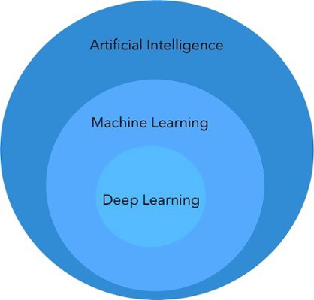
AI is a technique of getting machines to work and behave like humans.

Slide 2
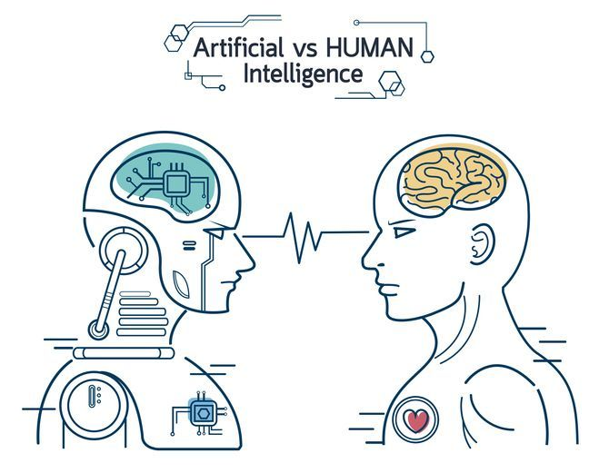
Image Processing
Computer Vision
Neural Network
Natural Language Processing

Slide 3
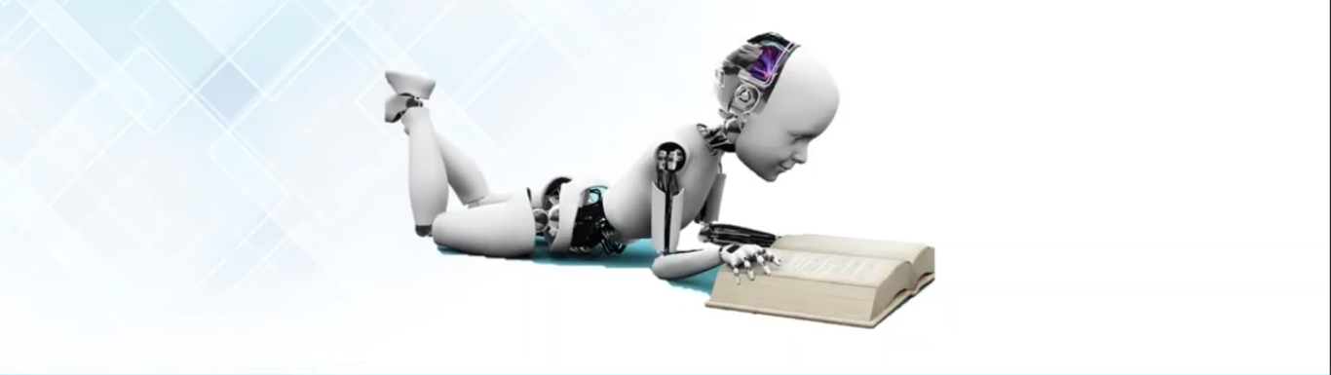
Machine Learning
Machine learning is an application of artificial intelligence (AI) that provides systems the ability to automatically learn and improve from experience without being explicitly programmed.

Slide 4
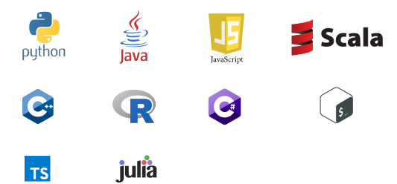

Machine learning and AI are built on mathematical principles like Calculus, Linear Algebra, Probability, Statistics, and Optimization

Slide 5
Business domain
Domain knowledge(cancer)
Data collection: Data Mining, web scrapping
Data Analytics: Data understanding, data visualization
Pre-processing: Prepare your data
Algorithms selection
Model creating
Model Testing (confusion matrix)
User test ()
Model deployment
Database connectivity

Slide 6
Machine Learning
Machine can learn automatically from previous experience without any explicitly knowledge
Data Collection (1000,5): Data Mining
Data Analysis
Data Pre-processing
Split into training and testing
Algorithm selection (Naïve Bayes)
Create model
Testing model (acc) 70%
Check with new data
Model Saving
Load model
Check with new data
Pipeling creation
Deployment (flask, Django, GUI, AWS, Heruku)
Connect with database

Slide 7
Supervised
Unsupervised
Reinforcement
Labelled dataset
Target value/ Result
unlabelled dataset
No Target value/ No Result
Q-Learning (Bellman equation)
Stock market prediction
Clustering: Grouping
K-mean clustering
Hierarchical clustering
Association Rule Learning: Recommendation system
Regression: continuous data
Linear Regression
KNN (K-Nearest Neighbour)
SVM (Support vector machine)
Decision Tree
Random Forest
Classification: categorical data
Logistic Regression
Naïve Bayes

